Slide 1

A
Seminar
On
WORKING BEHIND SNAPCHAT FILTERS
Presented by:
ADWITIYA MATHUR
2016088
Faculty Of Mathematics and Computing
BANASTHALI VIDYAPITH, RAJASTHAN
July- December, 2022

Slide 2
OUTLINES
History
Introduction
Computer vision
Pixelation
Pixel data
Face Detection
Locating facial features (active face model)
All three
Viola jones algorithm
Haar- like features
Darkness algo with Integral Image
Adaboost
Cascading Classifiers
References

Slide 3
HISTORY
A Ukrainian company , LOOKSERY
Snapchat acquired LOOKSERY
Snapchat introduces 'Discover' and 'Lenses'

Slide 4
INTRODUCTION
ARTIFICIAL INTELLIGENCE
SNAP.INC
MACHINE LEARNING
AUGMENTED REALITY

Slide 5
COMPUTER VISION
Uses pixel data from camera
Identify object & space
Tries to create a 3D space from image data
Computer vision is all about pattern recognition

Slide 6
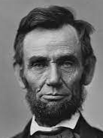
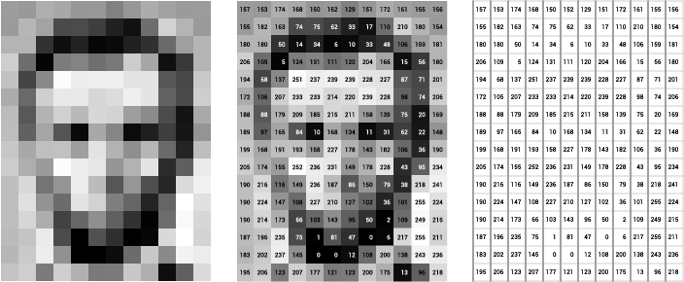
PIXELATION
Abraham Lincoln
Image resolution changed
Pixelated Abraham Lincoln​
Abraham Lincoln​'s image in numerated form

Slide 7
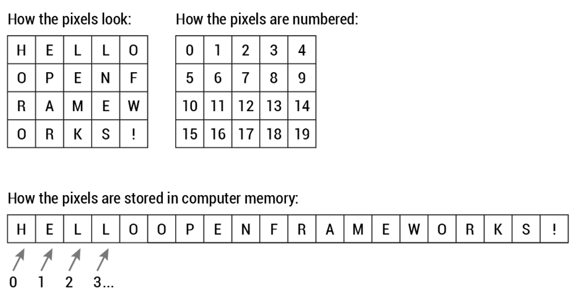
PIXEL DATA
Perceived as 2-D storage but its actual a linear storage in computer's memory ​

Slide 8
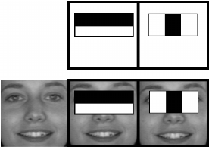
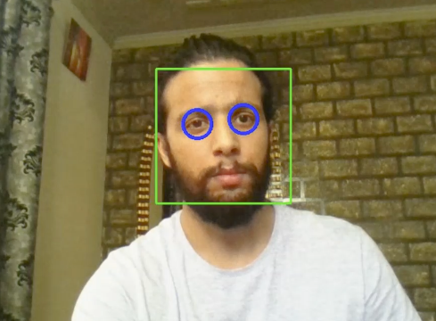
FACE DETECTION
Facial detection algorithm known as Viola-Jones Algorithm
Image Data
Light and dark parts of a grayscaled image

Slide 9
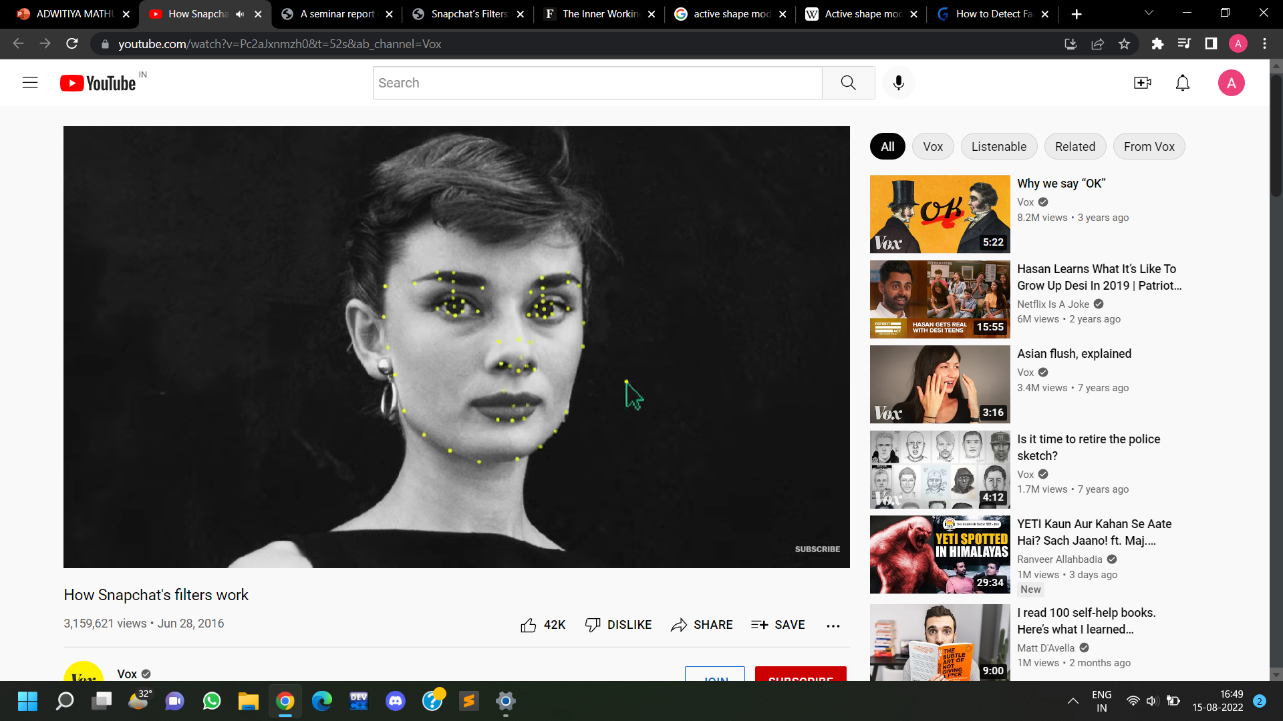
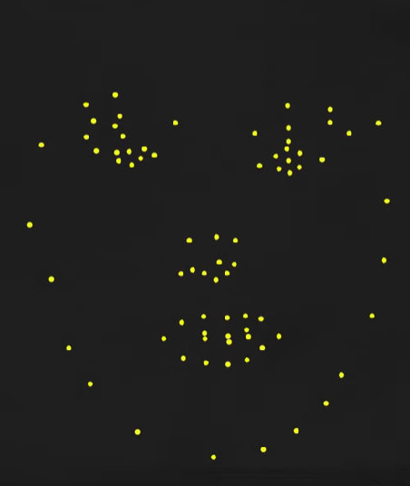
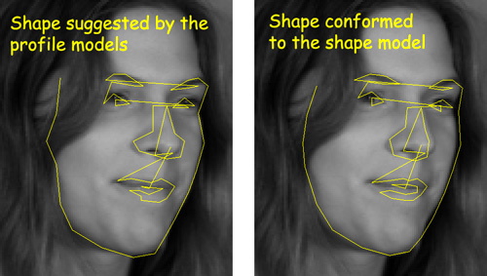
LOCATING FACIAL FEATURES
ACTIVE FACE MODEL
Manually mark boundaries
Average face from trained data
Trained data aligned with facial features

Slide 10
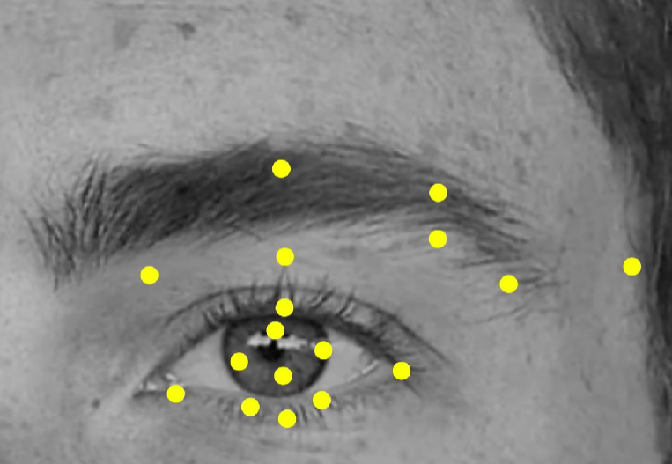
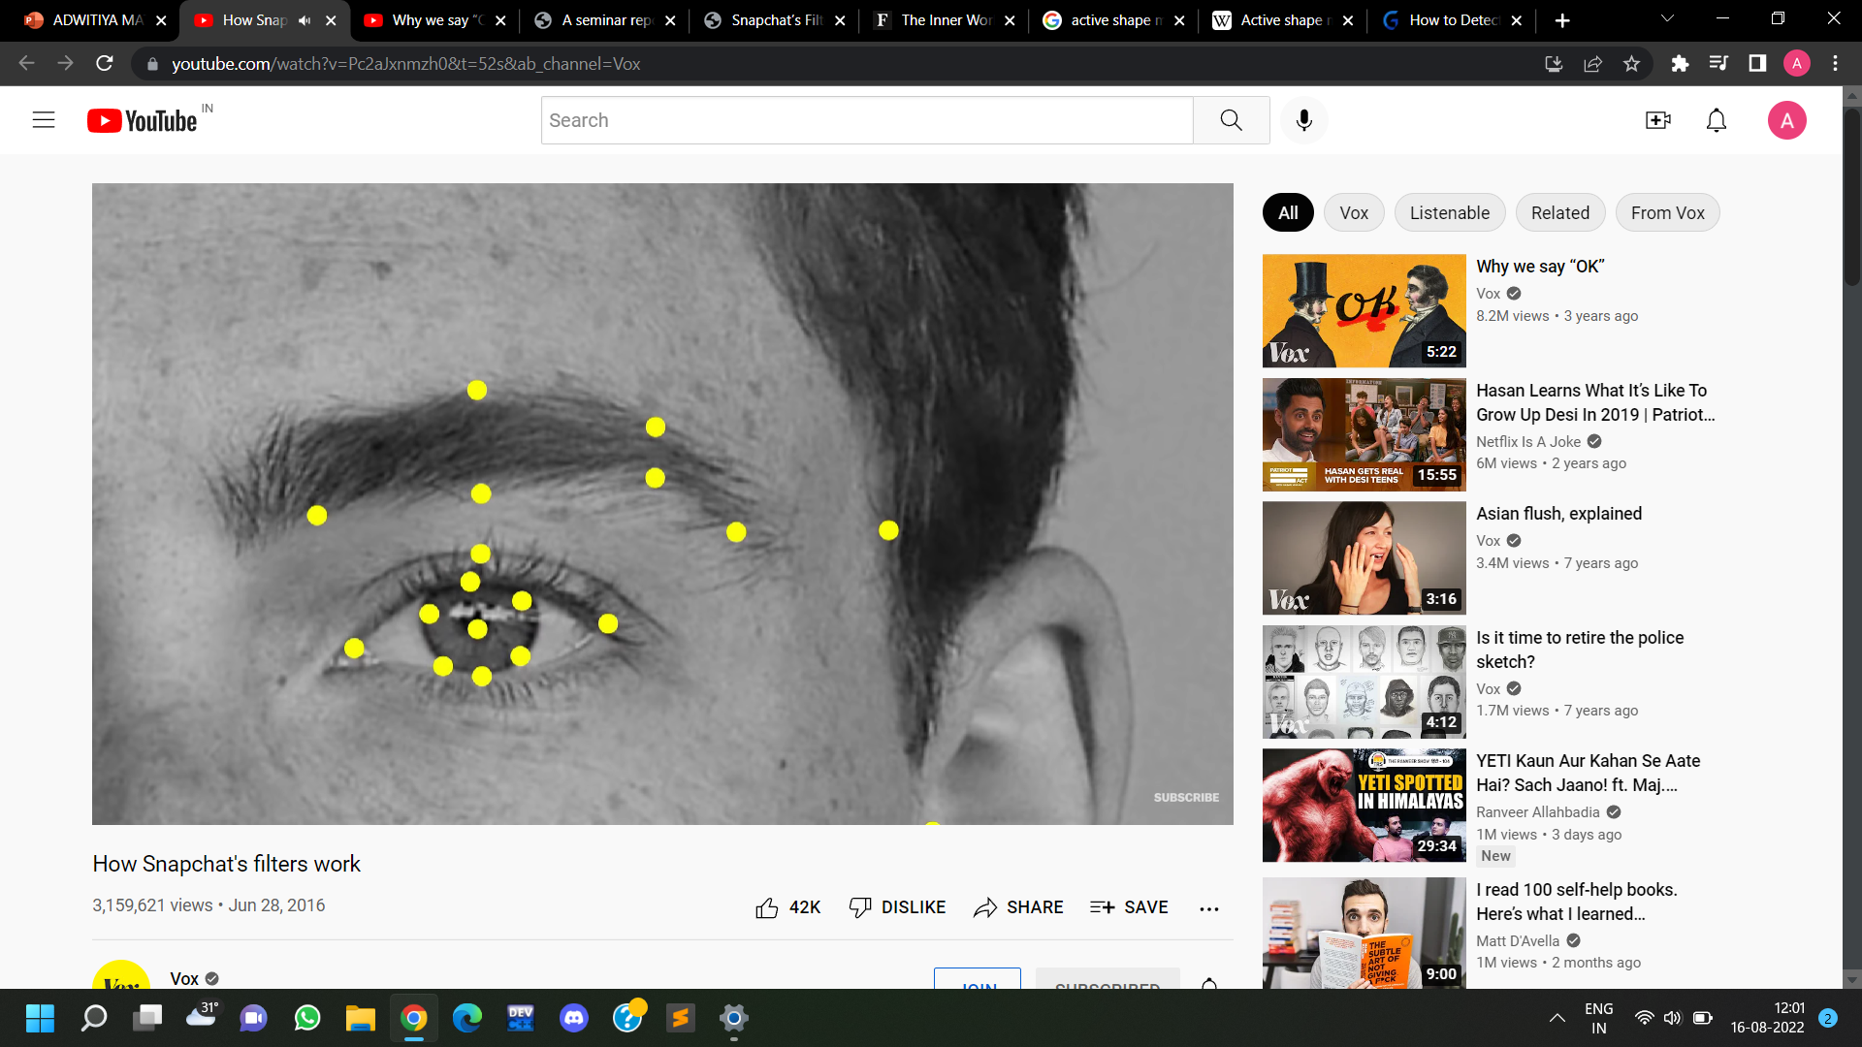
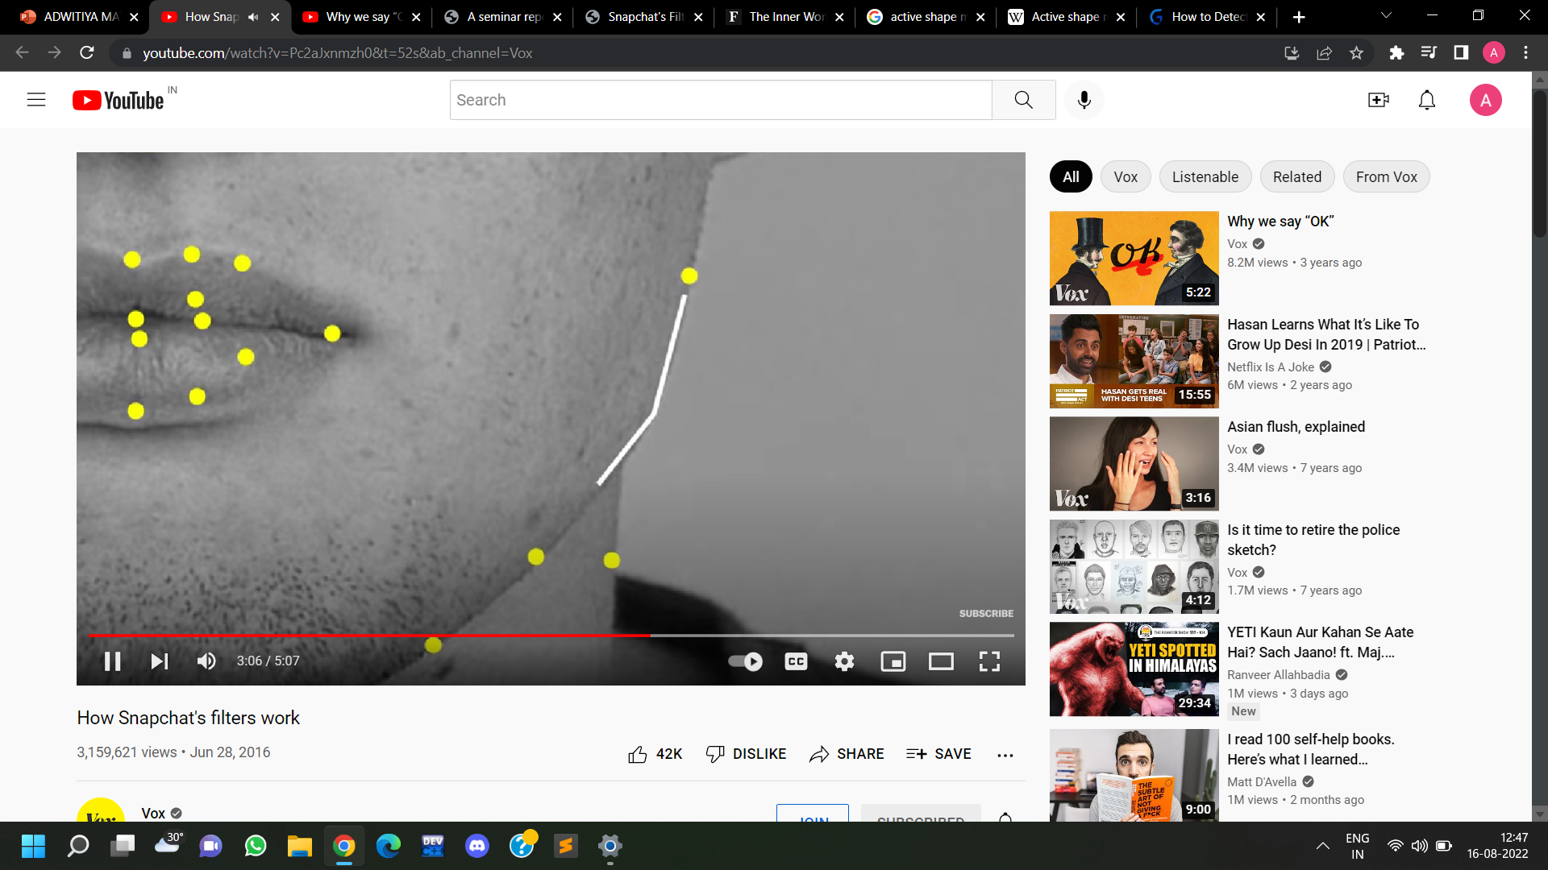
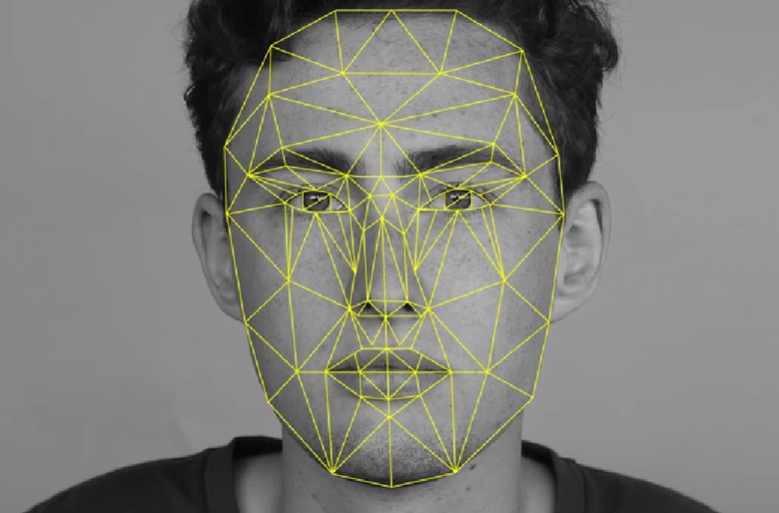
ALL THREE
Analyzing PIXEL DATA
GRAYSCALE
COORDINATE CREATION
Scaling, rotating and resizing to create boundaries to locate facial features
Dots joining to form an edge
Edges join to form a mesh-like structure

Slide 11
VIOLA JONES ALGORITHM
Paul Viola
Michael Jones
Viola–Jones Algorithm
algorithm works on grayscale image
algorithm looks at smaller subregions
tries to find a face by looking for specific features
check different positions and scales
uses Haar-like features to detect faces
2 features: Training and Detection.

Slide 12
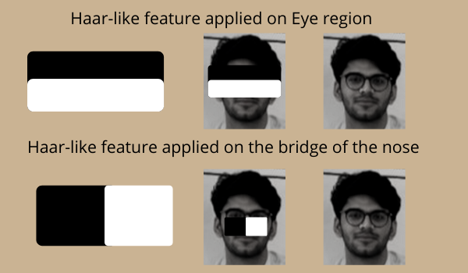

HAAR-LIKE FEATURES
Digital image features in obj. recognition
Two features
Edge-like features
Line-like features
Faces share universal features i.e. eyes region is darker than nose region.
Edge-like features
One dark & one light
Dark region btw light region
Line-like features

Slide 13
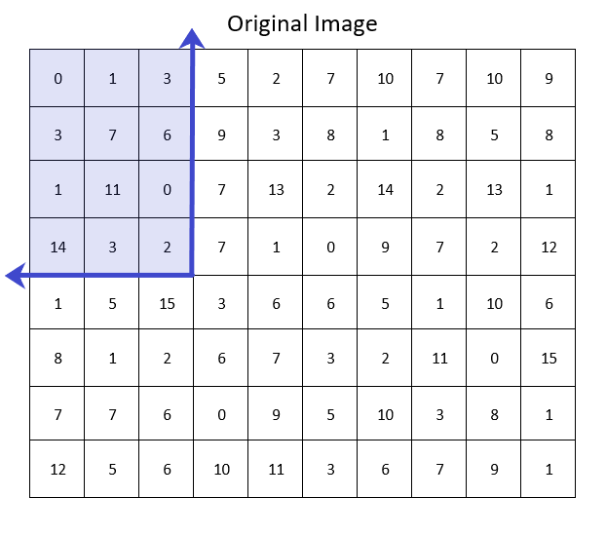
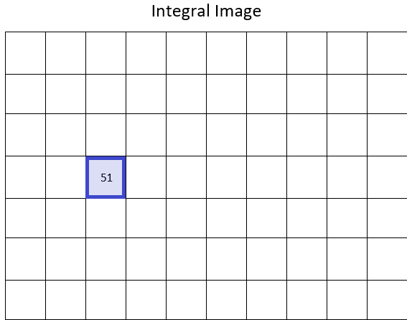
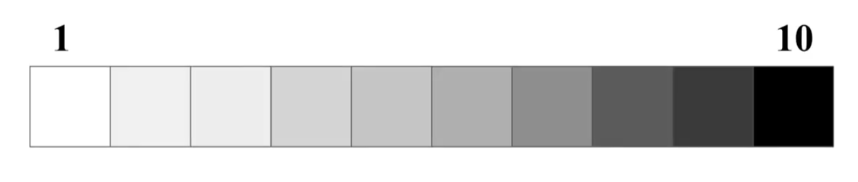
DARKNESS ALGO / INTEGRAL IMAGE
Finding average darkness 'A'
Finding sum of pixels above and left side of each square, creating new image.
Find percentage darkness & lightness

Slide 14
ADABOOST
But only some features are important in the face.
Finds best threshold, classifying faces into positive and negative.
Training to detecting min error-rate.

Slide 15
CASCADING CLASSIFIERS
Cascading quickly discard non-faces and avoid wasting time.
Setting-up cascading system
Step-I : Passed through best features
Step-II : Face evaluated; +ve -next stage , -ve - discarded
All steps cleared then human face detected

Slide 16
REFERENCES
Computer vision
https://towardsdatascience.com/everything-you-ever-wanted-to-know-about-computer-vision-heres-a-look-why-it-s-so-awesome-e8a58dfb641e
Active shape model
https://link.springer.com/chapter/10.1007/978-3-642-54851-2_1#:~:text=Active%20Shape%20Model%20(ASM)%20is,ASM%20to%20the%20face%20recognition
Facial detection
https://medium.com/analytics-vidhya/creating-snapchat-like-filters-from-scratch-using-computer-vision-techniques-6374cde6a7db
Viola-Jones Algorithm
https://www.mygreatlearning.com/blog/viola-jones-algorithm/#sh1
Adaboost
https://hub.packtpub.com/implementing-face-detection-using-haar-cascades-adaboost-algorithm/
Cascading Classifiers
https://www.sciencedirect.com/topics/computer-science/classifier-cascade

Slide 17
THANK YOU

